Slide 1


Creating a Life Saving Donation Service Area Culture
Helen W. Bottenfield

Slide 2


Slide 3
Healthcare Crisis
Hypertension
Obesity
Diabetes
Kidney, Heart & Liver Disease
Increasing need for transplantation
_{Waiting list candidates:}
_{>123,000}

Slide 4
Some Statistics
Currently, more than 123,000 individuals are awaiting organ transplants in the United States.
Approximately 2100 Pediatric Patients*
28,953 Organ Transplants Performed in 2013
14,257 Organ Donors in 2013
>47,000 corneas were transplanted in 2013
>1 million tissue transplants done each year and the surgical need for tissue steadily rising.
*as of August 2014; For specific numbers visit unos.org

Slide 5

Our Mission:
To maximize the gift of life and health through organ and tissue donation.

Slide 6
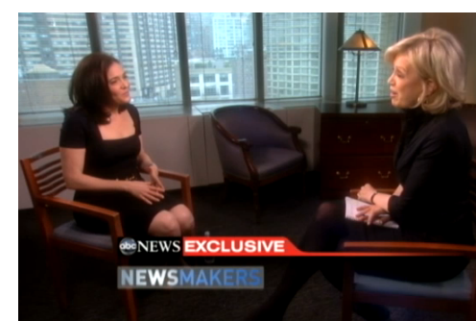
“Organ donation is not a medical crisis. It is a social crisis.”
Sheryl Sandberg,
COO, Facebook
Notes:
We have the technology but donations requires commitment of many individuals from many different organizations and communities!

Slide 7
DSA Leadership Team
Joint Accountability for DSA Performance
Donor Hospitals
NV Donor Registry
Local Transplant
Center
DSA
Leadership
Accountability For Performance
NDN

Slide 8
Preserving the Option of Donation
Over 49% of the adult U.S. population is registered to be an organ donor
More than 75% of families authorize donation when approached optimally
There are many psychological and grieving benefits for the families of donors that aid healing
Healthcare professionals have a professional duty to honor the designated wishes of the donor as an advanced directive.

Slide 9
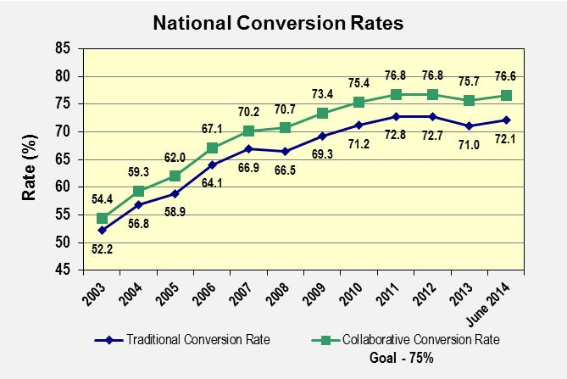
(OPTN Data, September 2014)

Slide 10
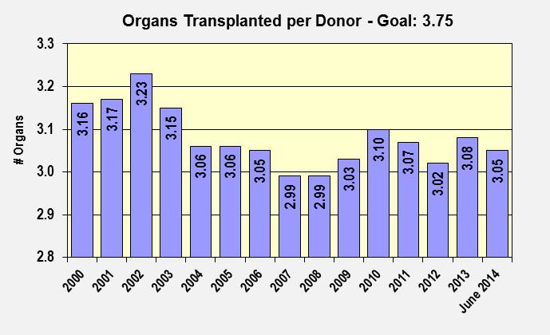
(OPTN Data, September 2014)

Slide 11
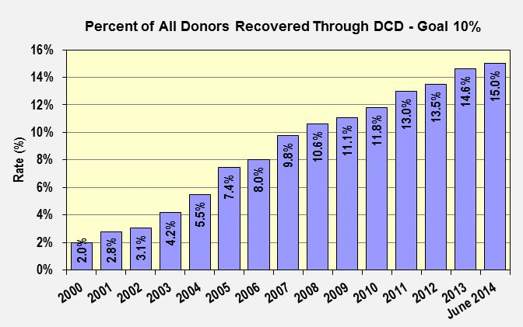
(OPTN Data, September 2014)

Slide 12




Think about this…
“Every system is perfectly designed to get exactly the results that it gets.”

Slide 13
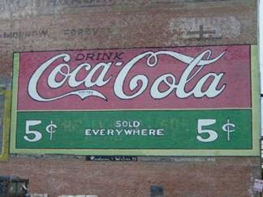

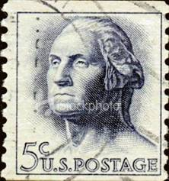

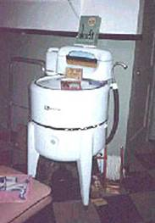

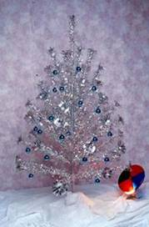
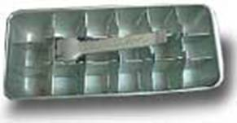
Change Happens!

Slide 14
Key Elements of
Breakthrough Improvement
Will to do what it takes to change to a new system
Ideas on which to base the design of the new system
Execution of the ideas

Slide 15
Overarching Strategies For
System Wide Improvement
Unrelenting Focus on Change, Improvement, and Results
Rapid, Early Referral & Linkage
Integrated Donation Process Management
Aggressive Pursuit of Every
Donation Opportunity
LEADERSHIP

Slide 16
High Leverage Changes:
Hospital/OPO Partnerships
Advocate Organ Donation As Mission
Involve Senior Leadership & Monitor Results
Hospital/OPO Team
Practice Timely Referral & Response
Effective Requesting
Support for Donations After Cardiac Death
Notes:
A closer look at some critical factors for performance excellence
THEY FALL INTO SIX AREAS OF ACTION
BUT THIS IS NOT MEANT TO BE THE DEFINITIVE LIST OF WHAT WORKS AND WHAT’S MAKING IT WORK.

Slide 17
DSA Culture
What does a Culture of Donation look like?
Who has it?
How do we create a positive & engaging one?
Notes:
DSA…DONATION SERVIVE AREA
This acronym has a whole new meaning than it did 10 years ago! Post national IHI Collaborative, it is clear that many partners serve the community to meet our donation and transplantation needs. A high performing system is hallmarked by this “CULTURE OF DONATION”. But, what does it really mean?
ASK ATTENDEES TO GIVE SOME EXAMPLES THAT MIGHT SHOW THEIR HOSPITAL HAS SUCH A CULTURE.

Slide 18
Positive & Productive
Invested in developing relationships & connections
Teams working on a common goal
Cooperation & Action
Bringing...
  Energy
  Enthusiasm
  Excitement & Engagement at all levels
Notes:
Many simple ways to accomplish this type of environment.
The OPO is seen as a hospital “insider”!

Slide 19
Communication
Clear, Open & Fluid
What are some effective ways you communicate with the members of your own donation team?
Notes:
How do they know YOU are a donation supporter?

Slide 20
A Culture of Donation
Just what is it?
How do you know it exists?
What can you do to help cultivate it?
What does it mean to your organization?
  To your community?
  To you and your family?

Slide 21
Hospital Leaders Speak…
“Culture comes from a feeling of personal responsibility, sympathy & empathy.”
“When you meet a donor family, you cannot help but be touched by the unselfish act of families.”
Linda Dean, Freeman Health System, Joplin MO

Slide 22

Creating a Culture of Donation
Starts at the top, leadership passion & commitment
May be a CNO, CMO, ICU Director or a team
Provide the structure & resources to assure success
Build on current organizational success
Make it a Quality and Safety imperative. Provide data & communicate often
Instills organizational focus and accountability
EILEEN WHALEN, MHA, RN
EXECUTIVE DIRECTOR, HARBORVIEW MEDICAL CENTER
Notes:
THESE COMMENTS FROM EILEEN WHALEN, EXEC. DIRECTOR, HARBORVIEW MEDICAL CENTER, SEATTLE
FROM PRESENTATION SHE GAVE ON THE CEO WEBINAR LAST MONTH. HER HOSPITAL IS VERY HIGH PERFORMING OVER THE PAST 4 YEARS DUE TO THIS NEW CULTURE!
Culture:
Can do attitude
Dedicated to the mission we serve including organ donation
Transparency
Boardroom, overview of program, goals and metrics of success
Share letters, stories, routine data as with any quality initiative

Slide 23

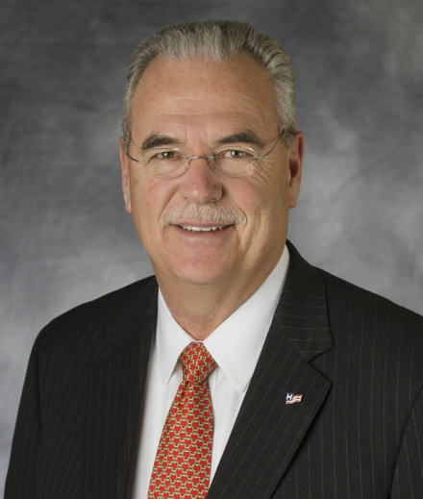

Increasing Organ, Eye &Tissue Donations
Rich Umbdenstock
President and CEO
American Hospital Association

Slide 24
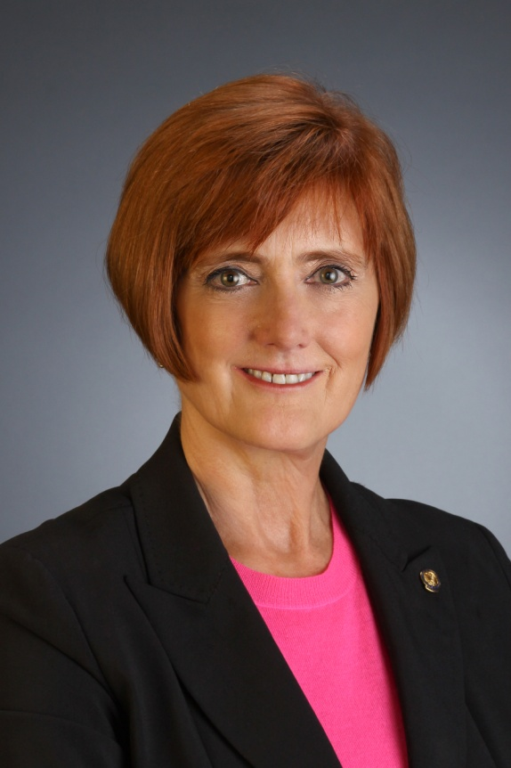

Promoting Organ Donation
A commitment by ACHE and its leaders …
Publications
Congress on Healthcare Leadership
ache.org
Research
Chapters
Deborah J. Bowen, FACHE, CAE
President and CEO

Slide 25
Establish Protocols and Systems
Demonstrate a commitment to donation and strong relationships with OPOs
Create a culture of support to maximize donation
Encourage members of the medical community to develop protocols reflecting best practices
Appoint a champion

Slide 26
Support Donation Education
Develop strong, ongoing public education programs
Participate in national, state and local government and private sector initiatives to promote donation
Serve as a role model

Slide 27
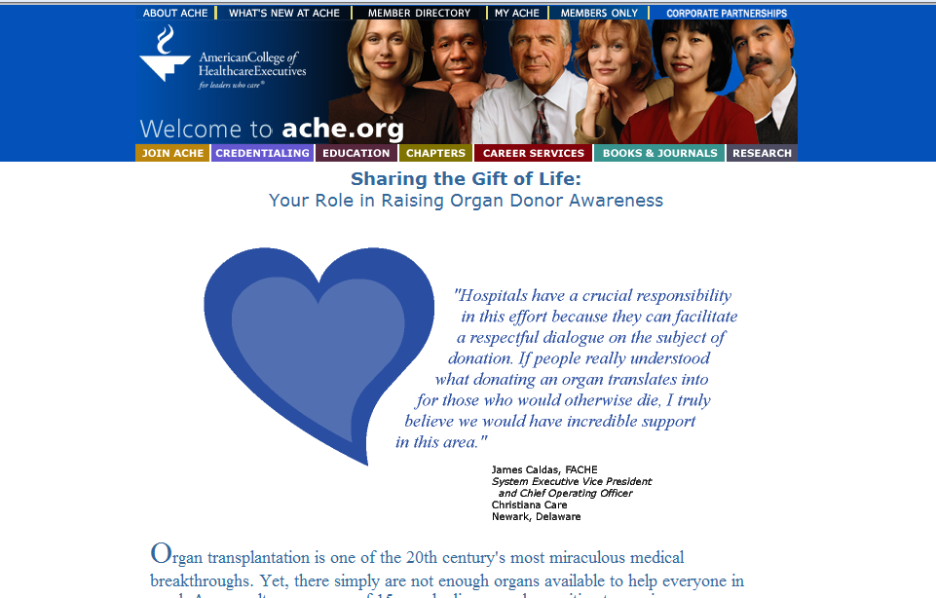
Sharing the Gift of Life

Slide 28
It’s ALL About Leadership!
Leadership is always a personal choice.
Leadership is standing for a compelling future.
The work of leadership is generating and delivering on commitments.
Leaders (Champions) tell leadership stories.
Leadership (Being a Champion) is interaction, not position or trait.

Slide 29
Donation & Transplantation Community of Practice Members
Donor hospitals
Transplant centers
OPO, Eye & Tissue Bank
State Donor Registry
Office of State Medical Examiner/Coroner
Healthcare organizations
Community organizations

Slide 30
TEAM?
Donation Service Area
DSA ActionTeam
A TEAM is a small number of people with complementary skills who are committed to a common purpose, set of performance goals, and approach for which they hold themselves accountable.
The Discipline of Teams
Jon Katzenbach & Douglas K. Smith

Slide 31
What is the greatest
TEAM you were ever on?
What made it great?

Slide 32
Partnership
FACT: Many hospitals and units have met or exceeded our national goals for referral and authorization.
How can we can help your hospital in reaching & maintaining a 100% timely referral rate & increased authorization rate?
Notes:
Where the rubber meets the road!
Engage audience to talk…give examples

Slide 33
Three Stage Approach to
Improvement Action
Organizing…Who? What? Why? How?
Performance Improvement…in action implementing best practices and testing new strategies
Hardwired.. managing and continuously improving high performance operations

Slide 34
Natural Partners & Resources
Nevada Donor Network
Office of the Medical Examiner/Coroner
Nevada Hospital Association
Donate Life Nevada
Families touched by organ, tissue and eye donation
Patients waiting for a gift of life
Transplant recipients

Slide 35
Questions to consider…
What is your hospitals biggest challenge in the current donation process?
How can you partner with NDN to eliminate barriers to improved performance and outcomes?
Who has a role in making the donation process work for patients
and families?

Slide 36

Notes:
IF NOT ME….THEN WHO?

Slide 37
What will YOU do now?
Some is not a number,
soon is not a time.
Donald Berwick, MD
Former CEO, IHI
Notes:
THE TIME TO ACT IS NOW!

Slide 38

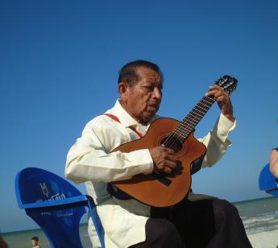
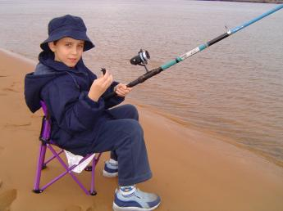
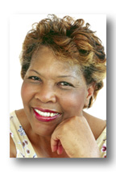
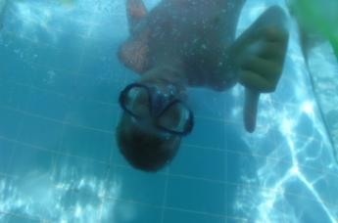
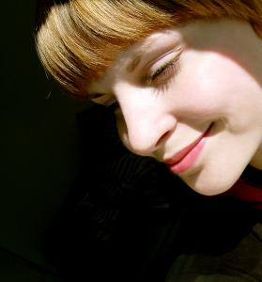
Putting a Face on Performance
It Really Is All About
the 1’s…
  1 Donor at a Time
  1 Donor Family at a Time
  1 Transplant Candidate at a Time
  1 Month at a Time
  1 Day at a Time
  ...and each 1 of
  YOU!
WE are HOPE
Notes:
IT’S ABOUT REAL PEOPLE…JUST LIKE YOU & ME!
LIFE CHANGES WHEN WE LEAST EXPECT IT! HOW WE RESPOND CAN MAKE A WORLD OF DIFFERENCE IN THE OUTCOME FOR THOUSANDS!

Slide 39
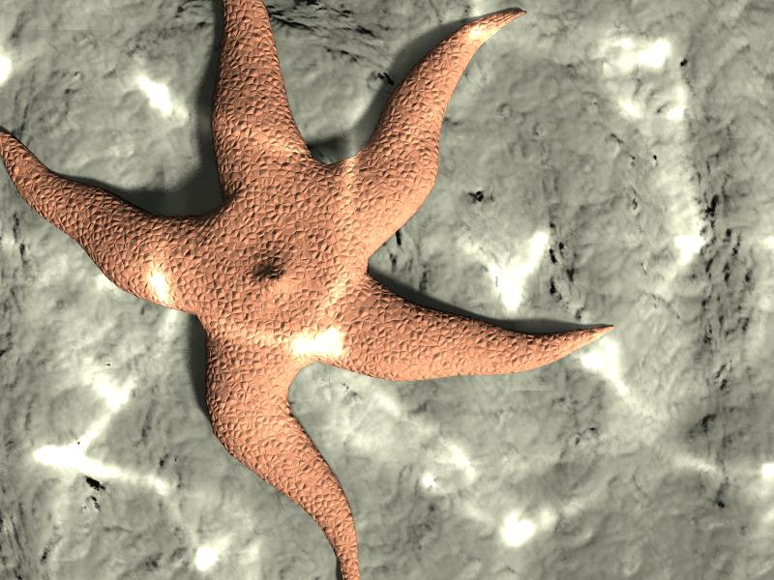

Slide 40

YOU have the Power… to Donate Life!
Notes:
THEME OF THE 2014 DONATE LIFE ROSE PARADE FLOAT…. LIGHT UP THE WORLD!
WILL YOU LIGHT IT UP!

Slide 41
I AM HOPE!
Will YOU say…..

