Slide 1

Nevada Donor Network
Donation After Circulatory Death

Slide 2

DCD – Everyone Plays a Role
Hospital Services
Family Services
Organ Services

Slide 3
Hospital Policy Challenges
Extubation only allowed in PACU
8-5 Monday – Friday
DCD not permitted, must transfer patient

Slide 4
Impact on Hospital Staff
Impact on Unit Staff
  Bedside Nurse accompanies patient, unit staff must cover for additional patients
  Patient may not have cardiac standstill within 60-90 minutes and may return to unit
Impact on OR and PACU Staff
  OR staff is not accustomed to having patients pass
  Can be tense in PACU with everyone, sometimes including family, waiting for cardiac standstill

Slide 5
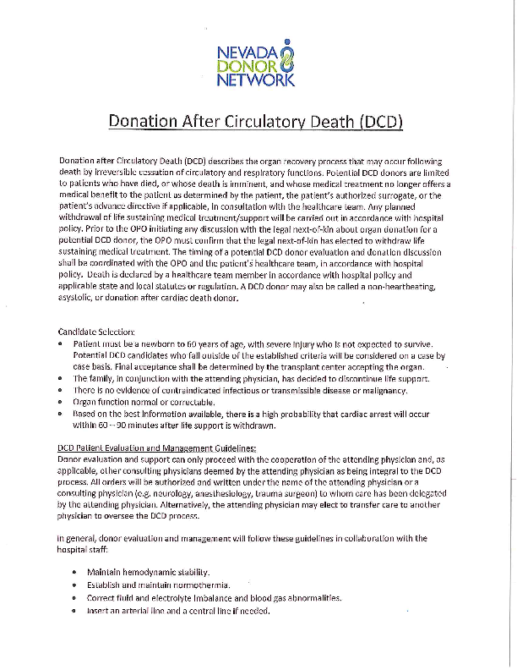
Education Provided
To aid with education of DCD process Hospital Services provides an educational piece on the DCD Process
  Patient Evaluation and Management Guidelines
  DCD Procedural Items

Slide 6
Meredith Hartstern
Hospital Services Coordinator mhartstern@nvdonor.org
702-816-9638

