Slide 1
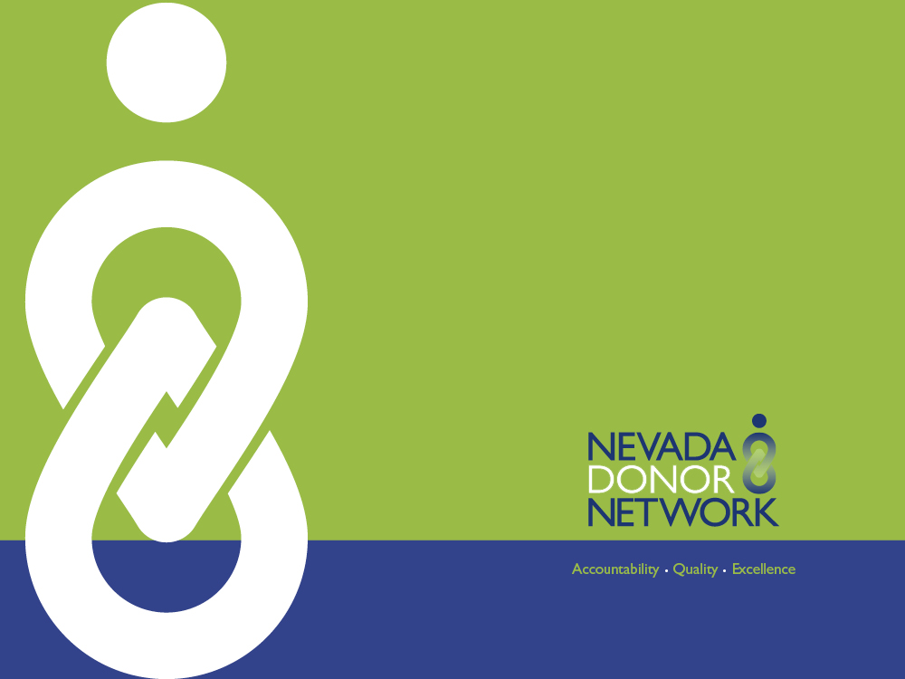
Nevada Donor Network
Pediatric Donation

Slide 2
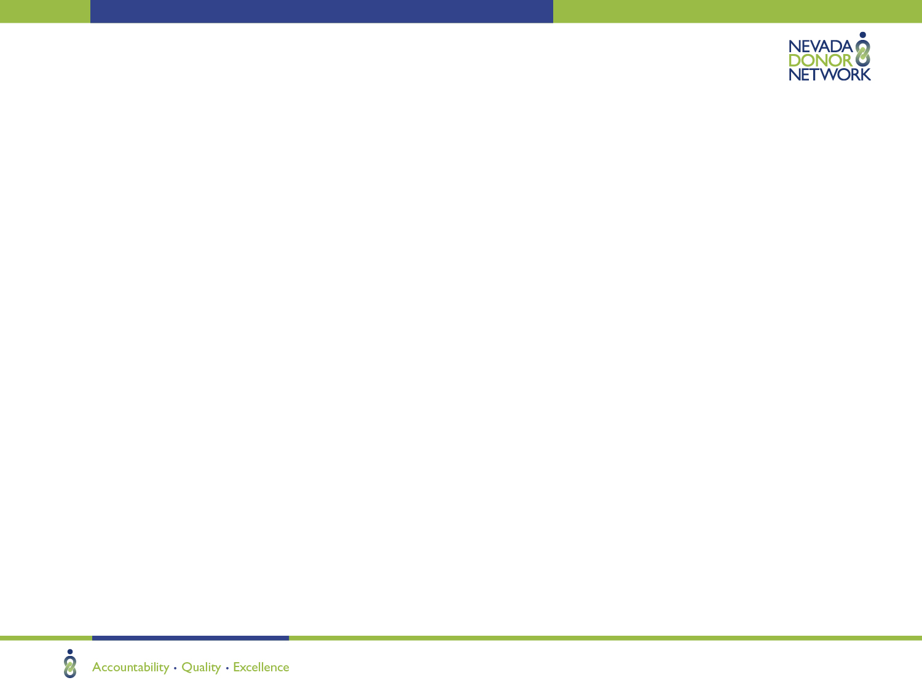
Who is Nevada Donor Network (NDN)?
Federally designated, not-for-profit organ, tissue, and eye procurement organization.
Responsible for the coordination, recovery, and distribution of donated human organs and tissues for transplantation and medical research
Participates in national organ and tissue sharing in an effort to meet the needs of patients awaiting transplants.

Slide 3
NDN Services
24-hour consultation and on-site donor evaluation
Support and offer families opportunity to donate
Donor management
Educational programs
Hospital donor policy & procedure development
Reimbursement of donor costs
Building relationships with hospitals, transplant centers, and the community

Slide 4
Centers for Medicare & Medicaid Services (CMS)
Conditions of Participation for Hospitals
  Requires all hospitals receiving Medicare funding to notify their local OPO of all deaths based on clinical triggers within 1 HOUR.
  The OPO determines medical suitability and ensures that all eligible families are offered the opportunity to donate.

Slide 5
HIPAA Privacy Rule on Organ & Tissue Donation
Hospital Staff are Authorized to Release Patient Information to NDN (OPO)
CFR § 164.512(h) – Final Rule
  A covered entity may use or disclose PHI to OPOs or other entities engaged in the procurement, banking, or transplantation of cadaveric organs, eyes or tissue for the purpose of facilitating organ, eye or tissue donation and transplantation.

Slide 6
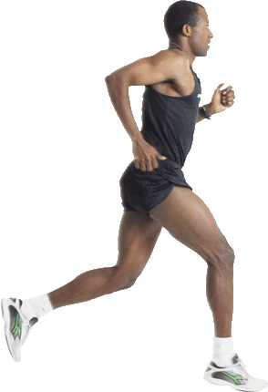
What is Transplantable for Adults?
ORGANS
◄
◄
TISSUES
◄
◄
◄
●
◄
◄
◄
◄
◄
◄
◄
● Kidneys
● Liver
● Heart
● Lungs
● Pancreas
● Sm. Intestine
●
Cornea/Eyes
Heart Valves
Veins
Skin
Bone
Tendons
Cartilage
◄
●
●
●
◄
●
◄
◄
◄
◄
◄
◄

Slide 7
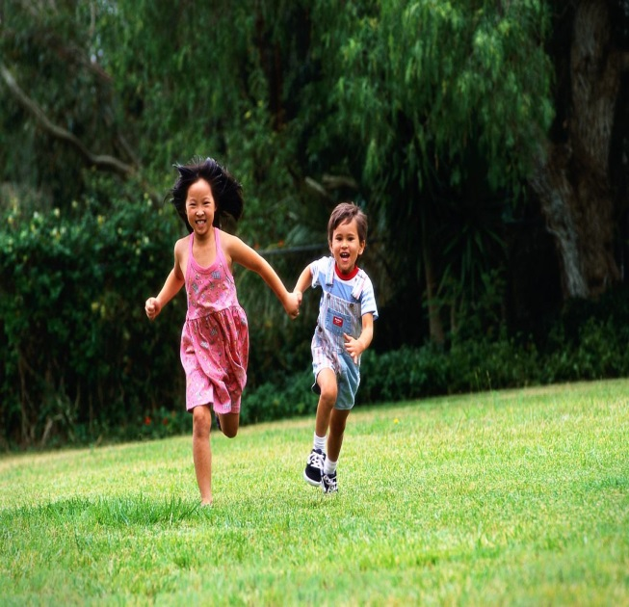
What is Transplantable for Pediatric Donors?
ORGANS
TISSUES
◄
◄
●
● Kidneys
● Liver
● Heart
● Lungs
● Pancreas
● Sm. Intestine
●
Corneas/Eyes
Heart Valves
◄
●
●
●
◄
●
◄
◄
◄

Slide 8
How are cardiac tissues recovered?
    The whole heart is recovered
    Heart valves are carefully dissected from the heart
    Cardiac tissue undergoes special processing that removes all of the donor cells
    Made into specialized cardiac grafts

Slide 9
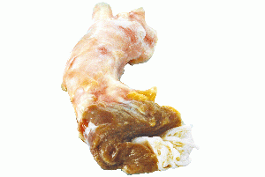
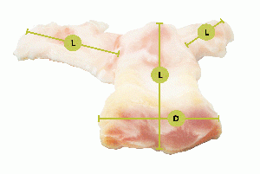
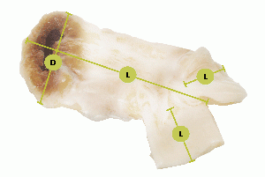
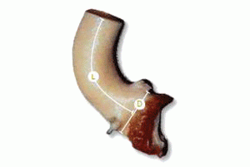
What are the different types and uses of cardiac grafts?
  Aortic Heart Valve
    Aortic stenosis
    Right ventricular outflow tract repair
  Pulmonary Heart Valve
    Hypoplastic left heart
    Ross procedure
  Pulmonary Artery
    Tetralogy of Fallot
    Truncus arteriosus
  Ascending Aorta
Notes:
Ross procedure (or pulmonary autograft) diseased aortic valve is replaced with the person's own pulmonary valve. A pulmonary allograft (valve taken from a cadaver) is then used to replace the patient's own pulmonary valve. Pulmonary autograft replacement of the aortic valve is the operation of choice in infants and children

Slide 10
What are the benefits of human tissue over mechanical or porcine grafts?
    No anticoagulation therapy required
    No immunosuppressive therapy required
    High resistance to infection
    Most closely resembles native tissue
Notes:
Grows with the child

Slide 11
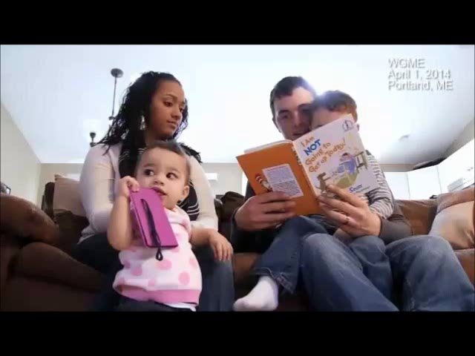
Recipients
The Gift of Life
Click here to play video
http://www.hlntv.com/video/2014/05/15/heart-heart-babys-gift-life

Slide 12
How can you help make this happen?
Call Nevada Donor Network within 1 hour for a patient who is:
    Vented with a GCS of ≤ 5 and a neurological illness or injury
    Vented and brain death is being considered or ordered
    Vented with a consideration of DNR or status change
    OR
    Within 1 hour of cardiac time of death

Slide 13
For additional information, contact:
Irma Sison, CTBS
Manager of Hospital Services
isison@nvdonor.org

