Slide 1

Nevada Donor Network
The Donation Process

Slide 2

Who is Nevada Donor Network (NDN)?
Federally designated, not-for-profit organ, tissue, and eye procurement organization.
Responsible for the coordination, recovery, and distribution of donated human organs and tissues for transplantation and medical research
Participates in national organ and tissue sharing in an effort to meet the needs of patients awaiting transplants.

Slide 3
NDN Services
24-hour consultation and on-site donor evaluation
Support and offer families opportunity to donate
Donor management
Educational programs
Hospital donor policy & procedure development
Reimbursement of donor costs
Building relationships with hospitals, transplant centers, and the community

Slide 4

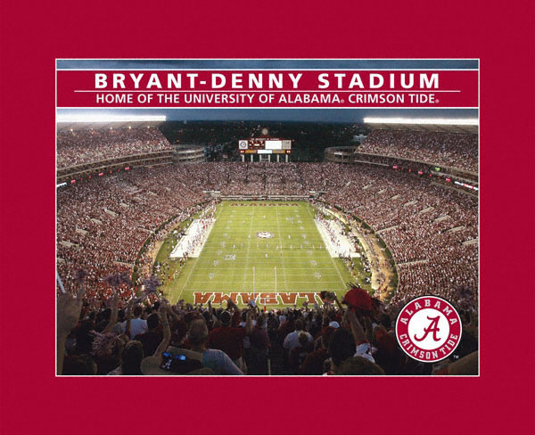
Statistics
Exactly how many people are waiting?
All Organs | 123,120
Kidneys | 95,334
Liver | 15,778
Pancreas | 1,189
Kidney/Pancreas | 2,058
Heart | 4,041
Lung | 1,614
Transplants (2013) | 31,127
Donors | 2013 Deceased 8268 Living 2279 total 14,257
http://optn.org 01-27-14

Slide 5
Nevada Donor Registry
www.nvdonor.org
Established in 2001
862,966 registered
First Person Authorization
Total Nevada Patients on Wait List 563
413 waiting for kidney transplant
Notes:
Nevada patients waiting as of Apr, 2013
Desired Organ
Heart 10, Kidney 399, Kidney-Pancreas 16, Liver 125, Lung 10, Pancreas 3, Total Patients 547

Slide 6
Benefits of a Donor Registry
Donor assured decision is honored
Family comforted by certainty of donor’s wishes
Family approach and organ recovery may be accelerated
More organs viable for transplant
MORE LIVES SAVED

Slide 7
Uniform Anatomical Gift Act 2007
www.leg.state.nv.us/NRS/NRS-451.html
Established donor registry & first person consent
Expanded consent options
Sets priorities – Transplant, Therapy, Research, Education
Provides legal protection for healthcare providers

Slide 8
How can you help make this happen?
Call Nevada Donor Network within 1 hour for a patient who is:
    Vented with a GCS of ≤ 5 and a neurological illness or injury
    Vented and brain death is being considered or ordered
    Vented with a consideration of DNR or status change
    OR
    Within 1 hour of cardiac time of death

Slide 9
Centers for Medicare & Medicaid Services (CMS)
Conditions of Participation for Hospitals
  Requires all hospitals receiving Medicare funding to notify their local OPO of all deaths based on clinical triggers within 1 HOUR.
  The OPO determines medical suitability and ensures that all eligible families are offered the opportunity to donate.

Slide 10
HIPAA Privacy Rule on Organ & Tissue Donation
Hospital Staff are Authorized to Release Patient Information to NDN (OPO)
CFR § 164.512(h) – Final Rule
  A covered entity may use or disclose PHI to OPOs or other entities engaged in the procurement, banking, or transplantation of cadaveric organs, eyes or tissue for the purpose of facilitating organ, eye or tissue donation and transplantation.

Slide 11
Every Opportunity Matters
2,100 New patients are added to the national organ donation waiting list every month
16 to 17 people die every day while waiting for transplant
10,000 to 14,000 people die each year meeting the criteria for organ donation, but….
Less than 1/2 of those people actually become organ donors

Slide 12

What is Transplantable for Adults?
ORGANS
◄
◄
TISSUES
◄
◄
◄
●
◄
◄
◄
◄
◄
◄
◄
● Kidneys
● Liver
● Heart
● Lungs
● Pancreas
● Sm. Intestine
●
Cornea/Eyes
Heart Valves
Veins
Skin
Bone
Tendons
Cartilage
◄
●
●
●
◄
●
◄
◄
◄
◄
◄
◄

Slide 13
Uniform Determination of Death Act 2007
NRS 451.007
A person is dead if he/she has sustained either:
    Total and irreversible loss of cardio-pulmonary function, or
    Total and irreversible loss of all brain function including the brain stem

Slide 14
Two Forms of Organ Donation
Donation after Brain Death
Manifest a non-survivable neurologic injury
Irreversible loss of all functions of the brain, including the brain stem
Declared brain dead through hospital policy
Donation after Cardiac Death
Family makes decision to
withdraw life-sustaining therapy
Patient not brain dead
Patient extubated in OR
Organ donation can occur after declaration of death
Notes:
Generally these pts are in the ICU on a vent. Pts that meet this criteria have experienced trauma, CVA, anoxia, etc.

Slide 15
The Organ Donation Process
Development
Referral
Evaluate
Approach
Recovery
Hospital
Services
Community Outreach
Identification & Early Referral Based on
Clinical Triggers
Suitability
Donor Mgmt.
Brain Death Declared
Donation After
Cardiac Death Assessment
Family
Support
Huddle
Effective
Requesting
Medical/Soc
History
Coroner Clearance
Organ Placement
Organ/Tissue Recovery

Slide 16
Your Role as a Nurse
Refer patient’s meeting clinical trigger (within one hour)
Provide NDN with patient’s clinical picture to assess donor suitability
Report any changes in patient’s status
Do not pre-mention donation to family
Participate in the “Huddle”
Continue to provide family support in collaboration with NDN

Slide 17
Role of the Physician
Identify the patient as potentially brain dead or suitable for DCD Donation
Perform and document a brain death exam
Inform the family of their loved one’s death
Do not pre-mention donor to family
Participate in the “Huddle” with NDN staff
The introduction of NDN staff to the family
Maintain patient care to preserve donation opportunity

Slide 18
The Purpose of the Huddle
Huddle is a pre-approach gathering between NDN and healthcare team to create a support system for potential donor families, in order to meet all of their needs
  Personal
  Cultural
  Spiritual
Huddle involves everyone that was a part of the patient’s / family care and ensure consistent communication between families, hospital staff and NDN personnel
To develop an environment for a successful outcome

Slide 19
The Approach
For many families donation is the only positive experience in the tragic chain of events
Families need information about donation to make an informed decision
Families are best served when hospitals & OPOs work together to offer the option of donation
Hospital staff is encouraged to bridge rather than approach

Slide 20
Bridging vs. Approaching
Preparing the family is introducing the family to end-of-life
specialists from Nevada Donor Network about donation opportunities.
Preparing the family stops short of discussing a
family’s donation decision or sharing information about donation

Slide 21
Process After Consent for Organ Donation
  Patient is discharged and readmitted under NDN
  A 1:1 nurse is to be assigned to patient
  NDN Procurement Transplant Coordinators (PTCs) are on site to facilitate any labs that need to be drawn for testing
  NDN examines patient and determines which organs are suitable for transplant

Slide 22
Process After Consent for Organ Donation
  A PTC will remain on site to manage patient and work with bedside nurse
  PTC allocates organs through UNOS and coordinates with multiple recovery teams to set an OR time
  Once an OR time is set, patient is transported to OR for recovery.
  After organs are recovered in the OR, the body can be released to designated funeral home.

Slide 23
Data Measured
  Monthly reports are provided to hospital
    Provides an outcome of cases
    Used as an indicator for improvement
  Data provided
    Organ & Tissue Referrals
    Organs Recovered & Transplanted
    Timely Referral Rates
    Late & Missed Referrals
    Approaches (appropriate and inappropriate)

Slide 24
Key Points to Remember
  Refer a patient to 800-350-9517 when a ventilated patient meets one of the clinical triggers
  Refer every cardiac death within 1 hour to 800-350-9517
  Do not approach a patient’s family about donation. If they inquire about it simply state you will have an end of life specialist speak with them. At that point contact Nevada Donor Network at 800-350-9517.
  Lives are able to be saved and enhanced even though tragic circumstances.

